Slide 1
Heuristic Optimization Methods Pareto Multiobjective Optimization
Patrick N. Ngatchou, Anahita Zarei, Warren L. J. Fox, and
Mohamed A. El-Sharkawi

Slide 2
10.1 INTRODUCTION
Compared with single-objective (SO) optimization problems, which have a unique solution, the solution to multiobjective (MO) problems consists of sets of tradeoffs between objectives.
The goal of multiobjective optimization (MOO) algorithms is to generate these trade-offs.

Slide 3
System engineers may desire to know all possible optimized solutions of all objectives simultaneously.
In the business world, it is known as a trade-off analysis.

Slide 4
10.2 BASIC PRINCIPLES
A hypothetical problem of determining, given a choice of transportation means, the most efficient of them based on distance covered in a day and energy used
In a MOO framework, the two objectives are maximization of distance (or equivalently, minimization of 1/distance) and minimization of energy in the process.

Slide 5
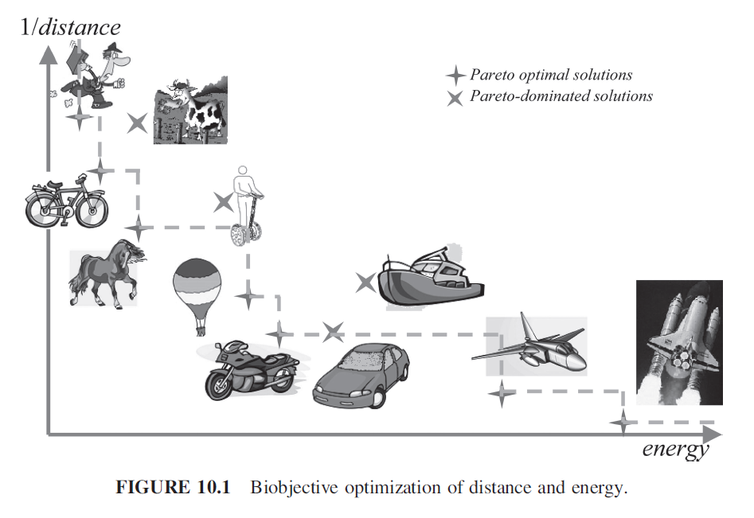
The points on the dotted line represent a
set of optimum solutions.

Slide 6
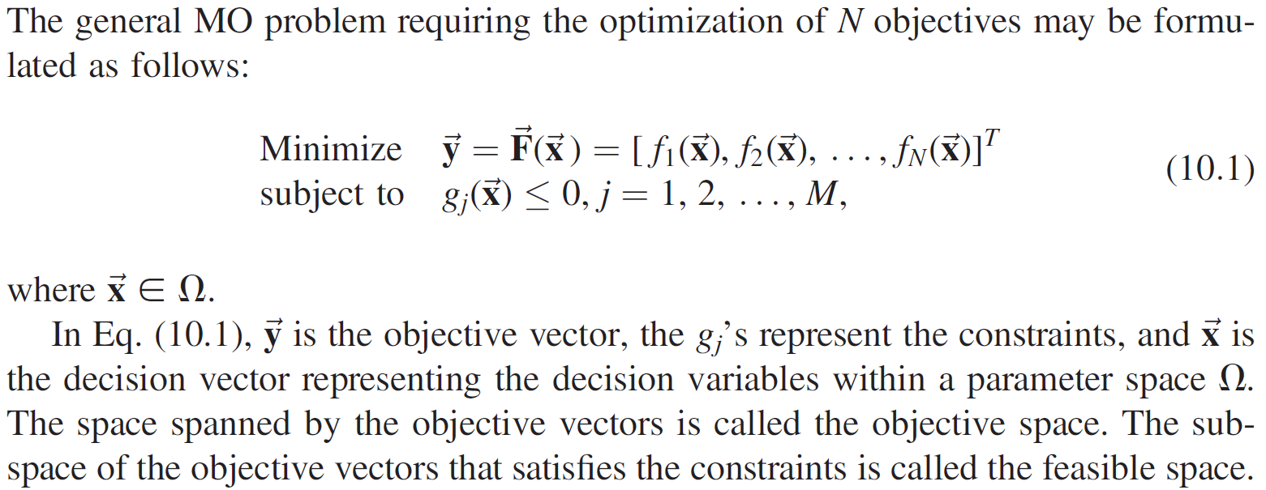
10.2.1 Generic Formulation of MO Problems

Slide 7
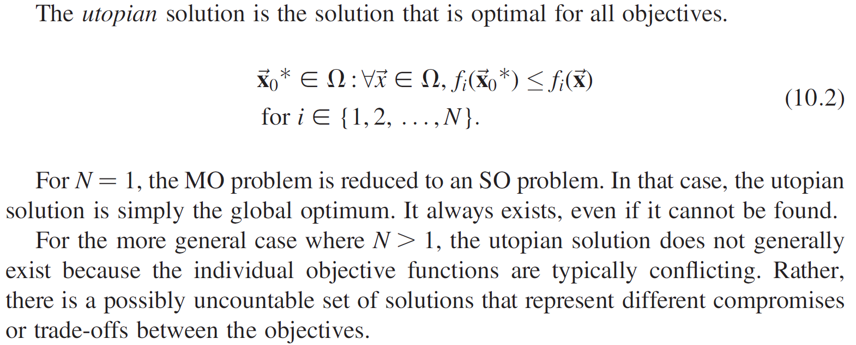

Slide 8
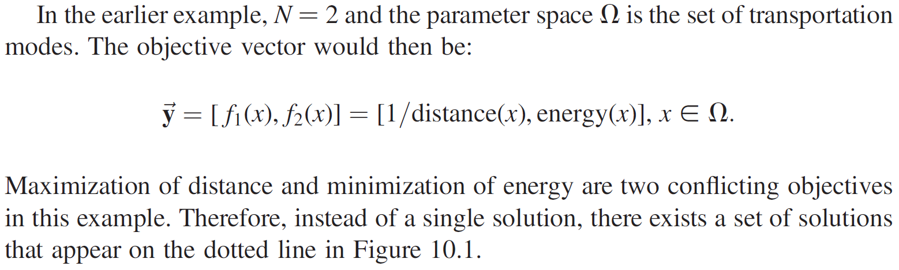

Slide 9
10.2.2 Pareto Optimality Concepts
To compare candidate solutions to the MO problems, the concepts of Pareto dominance and Pareto optimality are commonly used.
These concepts were originally introduced by Francis Ysidro and then generalized by Vilfredo Pareto [3].
A solution belongs to the Pareto set if there is no other solution that can improve at least one of the objectives without degrading any other objective.

Slide 10
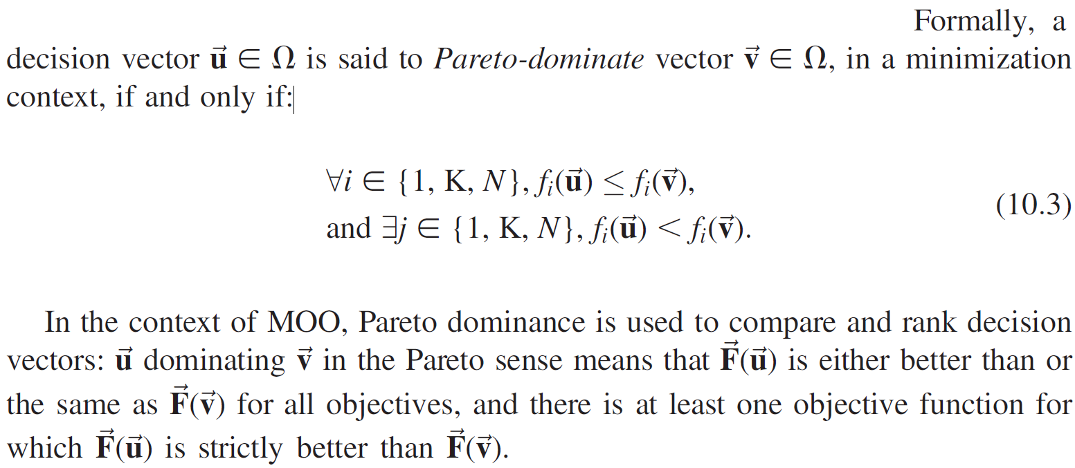

Slide 11
For instance, in Figure 10.1, a motorcycle Pareto dominates a car, because f₁(motorcycle) = f₁(car) (a motorcycle travels the same distance as a car), and f₂ (motorcycle) < f₂(car) (a motorcycle consumes less energy than a car).

Slide 12
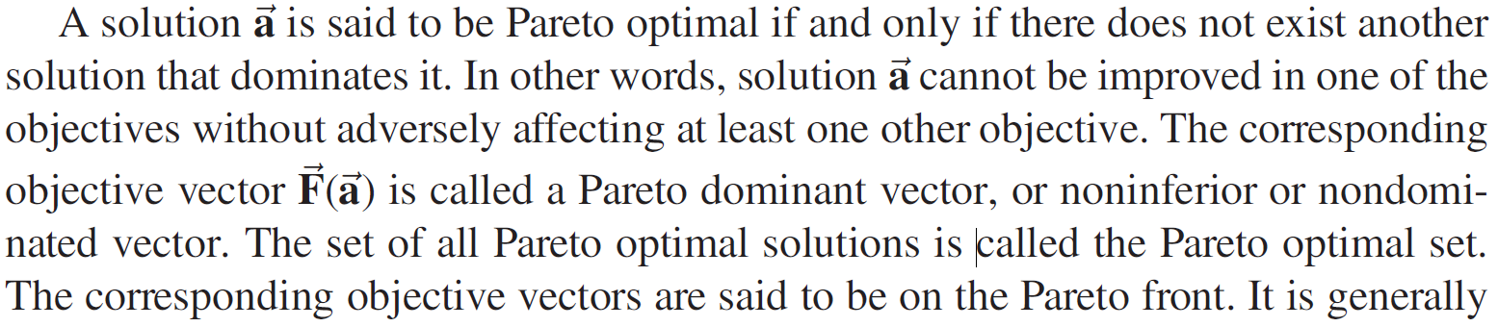

Slide 13
On Fig. 10.1, the Pareto optimal set consists of points on the dotted line.
The boat, scooter, and cow do not belong to the Pareto optimal set. For instance, the scooter cannot belong to the Pareto optimal set due to the presence of another element, the horse, which improves both objectives by traveling a longer distance and consuming less energy.
Similarly, the bicycle and horse both Pareto-dominate the cow, and the balloon, motorcycle, and car Pareto-dominate the boat.

Slide 14
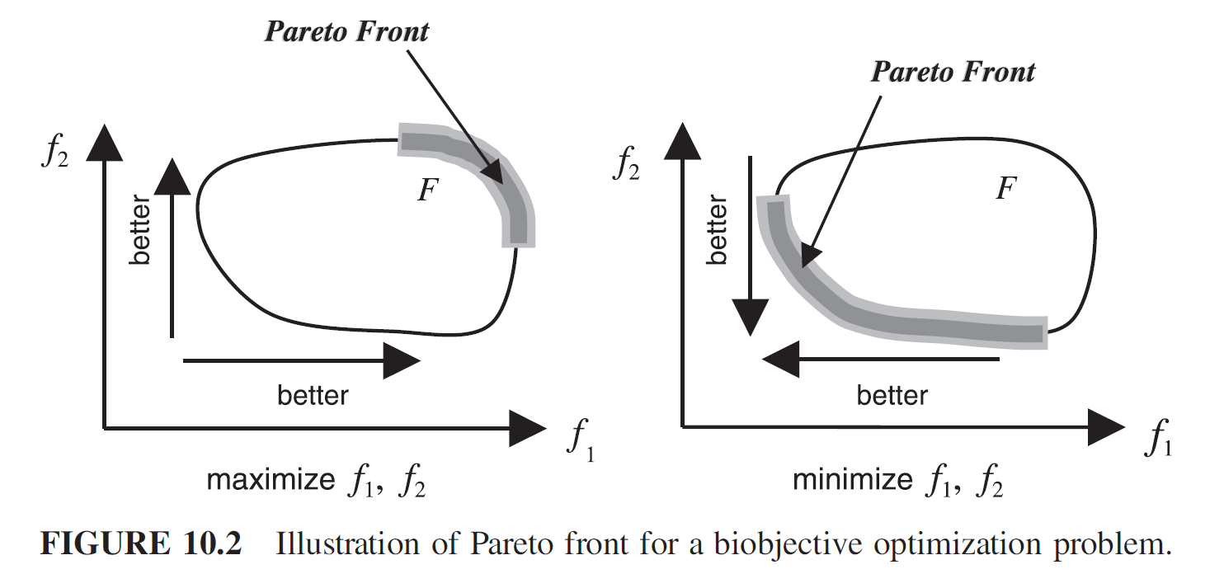

Slide 15
10.2.3 Objectives of Multiobjective Optimization
MOO consists of determining all solutions to the MO problem that are optimal in the Pareto sense.
The objective of MOO is to determine the best approximation to this Pareto optimal set.

Slide 16
Solving MO problems is itself a multiobjective problem. The objectives are to
Minimize the distance between the approximation set generated by the algorithm and the Pareto front;
Ensure a good distribution of solutions along the approximation set (uniform if possible);
Maximize the range covered by solutions along each of the objectives.

Slide 17
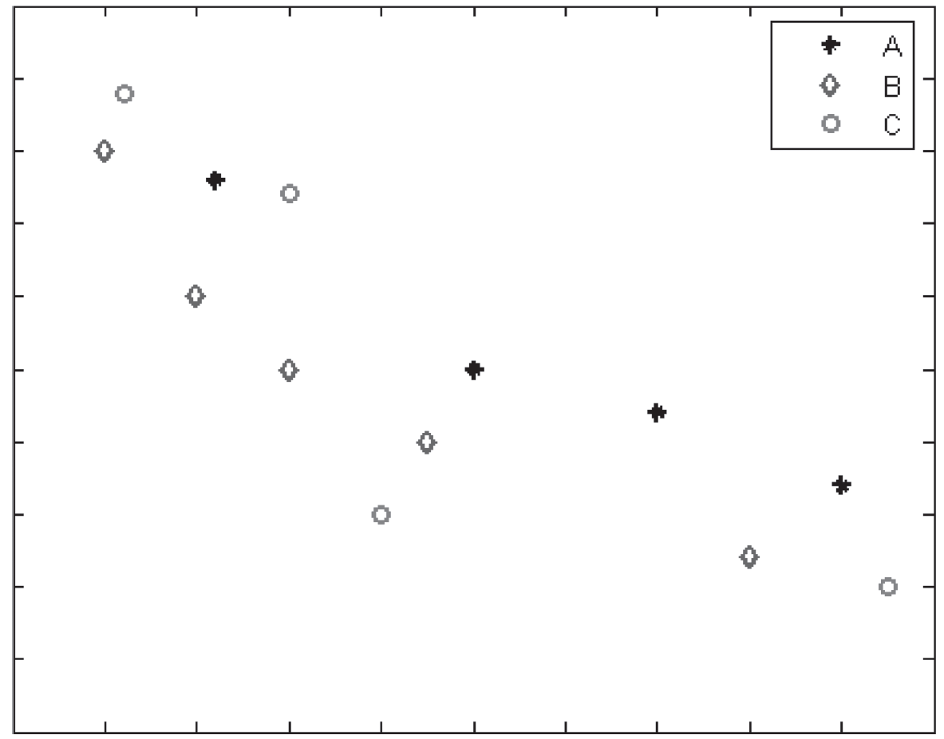

Slide 18
FIGURE 10.3 Illustration of the difficulty in comparing solutions to MO problems and motivating the objectives of MOO. In the objective space, we represent three hypothetical solutions of a biobjective minimization problem.
The distribution of trade-off points in set A is fairly uniform, but the objective space coverage range is not good as for sets B and C.
Set C covers the largest range but does not have a good distribution. Set B falls somewhere in between sets A and C.
A good MOO Algorithm will try to generate an approximation set with a uniform distribution of trade-off points that at the same time covers the largest range in the objective space and is very close to the Pareto front.

Slide 19
10.3 SOLUTION APPROACHES
Classic approaches, which have roots in the operations research and optimization theory fields, essentially consist of converting the MO problem into a SO problem, which then can be solved using traditional scalar optimization techniques.

Slide 20
The use of population-based meta-heuristics characterizes the second class of MO solvers, which is historically more recent. Indeed, population-based algorithms such as evolutionary algorithms, particle swarm optimization, or ant colony optimization allow direct generation of trade-off curves in a single run.
Hence, the modern techniques are geared toward direct determination of the Pareto front by optimizing all the objectives concurrently.

Slide 21
10.3.1 Classic Methods
Classic methods were essentially techniques developed by the operations research community to address the problem of multicriteria decision making (MCDM).
Given multiple objectives and preferential information about these objectives, the MO problem is converted into an SO problem by either aggregating the objective functions or optimizing the most important objective and treating the others as constraints.

Slide 22
Using either ranking the objectives in order of importance, or target optimal values for each objective, the goal is to find the solution that best satisfies the criteria and additional information (preferences) provided by the Decision Maker (DM).
In the general case, and in order to generate an approximation to the nondominated front, all that is needed is to modify the aggregation parameters and solve the newly created SO problem.

Slide 23
10.3.1.1 Weighted Aggregation
A simple and still very popular method is the weighted aggregation method.
This is a special case of the utility function method, which converts the MO problem into an SO problem by applying a function operator to the objective vector. This function is designed by the DM to capture their preferences.

Slide 24
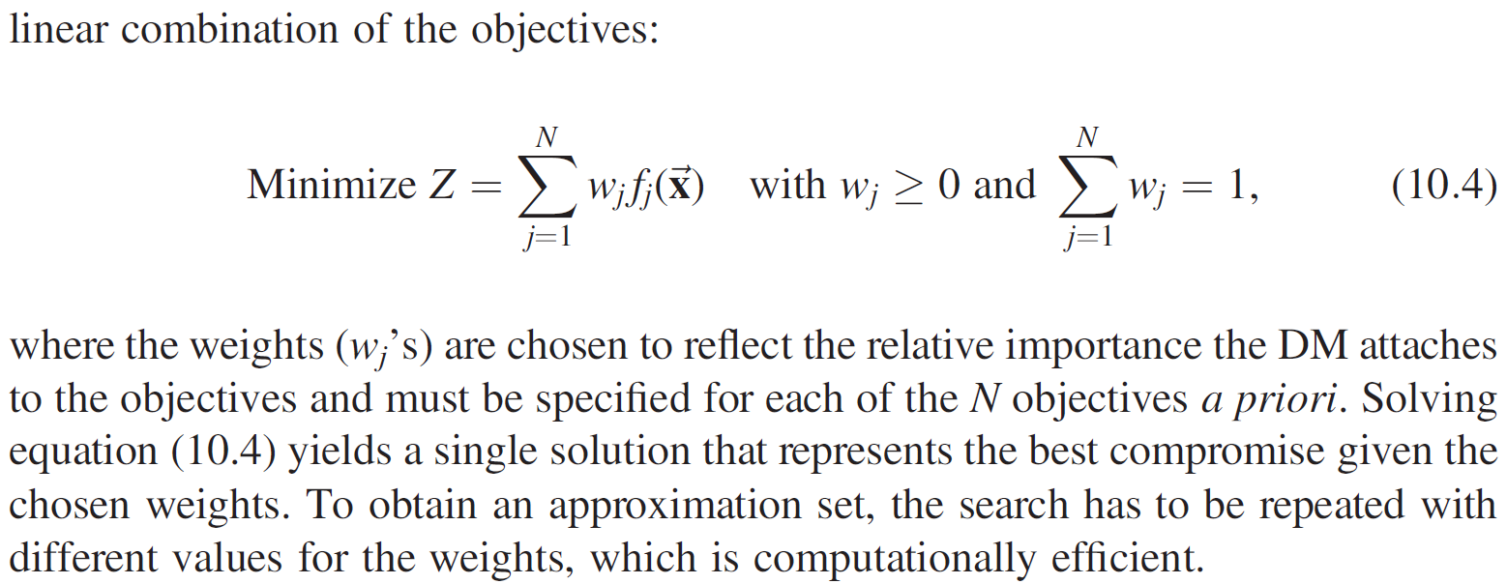

Slide 25
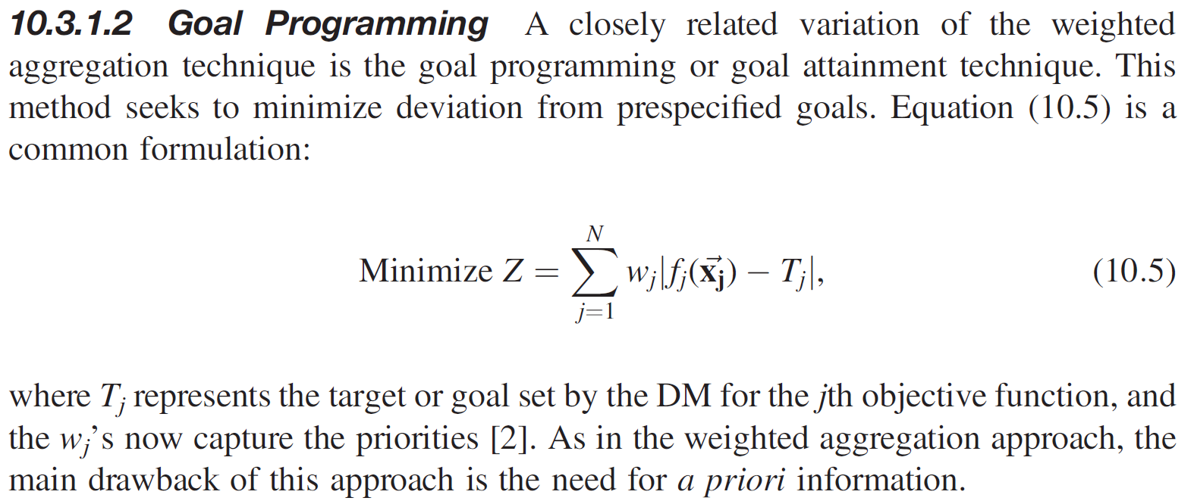
10.3.1.2 Goal Programming

Slide 26
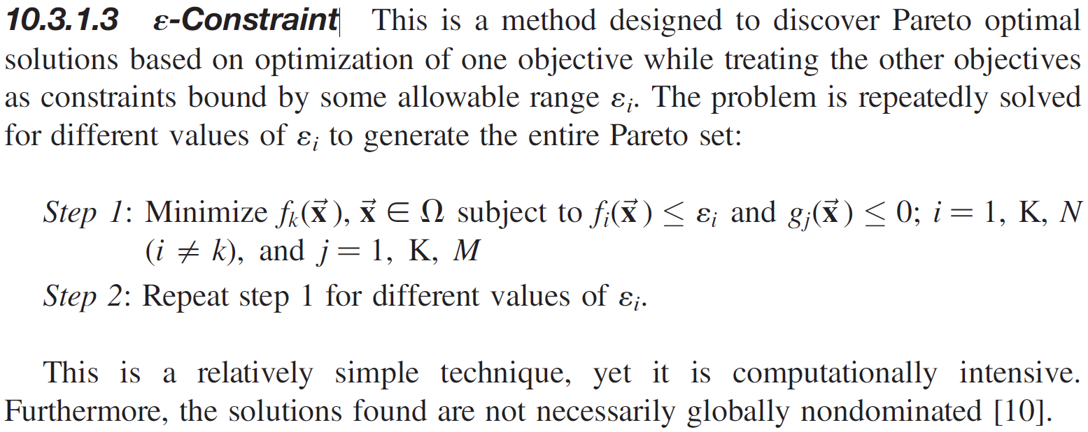
10.3.1.3 ε-Constraint

Slide 27
10.3.1.4 Discussion on Classic Methods
Classic methods attempt to ease the decision-making process by incorporating a priori preferential information from the DM and are geared toward finding the single solution representing the best compromise solution.
To examine all possible trade-offs requires systematic variation of the aggregation parameters before solving the problem, which makes the approach inefficient although simple to implement.

Slide 28
It is difficult to control the diversity of solutions in the approximation set, and more importantly.
The techniques are sensitive to the shape of the global Pareto front.

Slide 29
10.3.2 Intelligent Methods

Slide 30
10.3.2.1 Background
Meta-heuristics are a practical way to generate acceptable solutions, even though they cannot guarantee optimality.
Another advantage is the ability to incorporate problem-specific knowledge to improve the quality of the solutions.
Several variants of meta-heuristic algorithms exist: single-point stochastic search algorithms such as simulated annealing, or population-based algorithms such as evolutionary algorithms of which genetic algorithms are a special class.

Slide 31
When applied to MO problems, population-based algorithms can generate an approximation of the Pareto front in a single iteration.

Slide 32
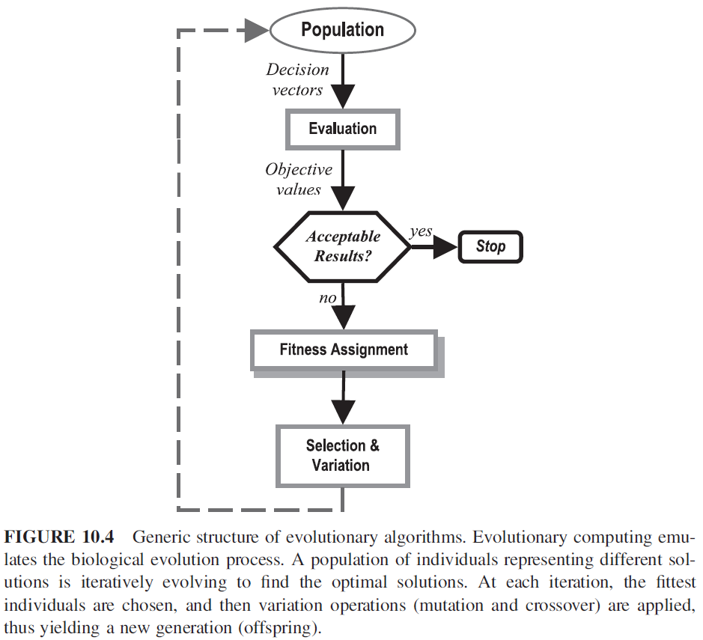
10.3.2.2 Structure of Population-Based MOO Solvers

Slide 33
Fitness assignment controls convergence (i.e., how to guide the population to nondominated solutions).
To prevent premature convergence to a region of the front, diversity mechanisms such as niching are included in the determination of an individual’s fitness.
Diversity also allows one to control the spread of the approximation set.
Finally, a form of elitism is applied to prevent the deterioration problem whereby nondominated solutions may disappear from one generation to the next.
Once fitness of individuals is computed, selection and variation can be performed.

Slide 34
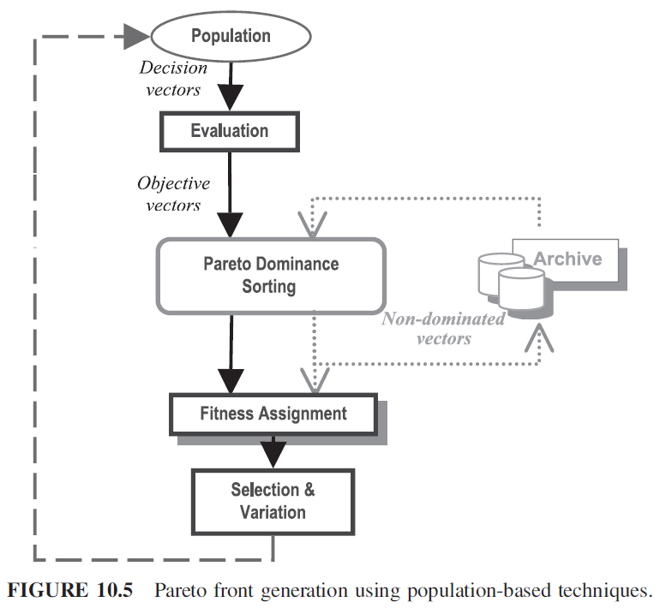

Slide 35
10.3.2.2.1 Fitness Assignment
There are three methods of fitness assignment: aggregation-based, criterion-based, and Pareto-based.
Aggregation-based assignment consists in evaluating the fitness of each individual based on a weighted aggregation of the objectives.
In this sense, it is an extension of the classic weighted aggregation method presented in Section 10.3.1.
An early implementation of this technique is Haleja & Lin’s genetic algorithm (HLGA). To explore the different parts of the Pareto front, they apply systematic variation of the aggregation weights [11].

Slide 36
An example of criterion-based assignment is Schaffer’s vector-evaluated genetic algorithm (VEGA) [14], which is a non–Pareto-based technique that differs from the conventional genetic algorithm only in the way in which the selection step is performed.
At each generation, the population is divided into as many equal-size subgroups as there are objectives, and the fittest individuals for each objective function are selected (Fig. 10.6).

Slide 37
The VEGA algorithm is easy to implement. However, it suffers from the speciation problem (i.e., evolution of species that excel in one of the objectives).
This causes the algorithm to fail to generate compromise solutions (i.e., solutions that are not necessarily the best in one objective but are optimal in the Pareto sense).
In addition, the algorithm is sensitive to the shape of the Pareto front.

Slide 38
Pareto-based fitness assignment is the most popular and efficient technique.
Pareto-dominance is explicitly applied in order to determine the probability of replication of an individual.

Slide 39
Given a population, a simple method is to find the set of nondominated individuals. These are assigned the highest rank and eliminated from further contention.
The process is then repeated with the remaining individuals until the entire population is ranked and assigned a fitness value proportional to the ranks.
The multiobjective genetic algorithm (MOGA) is an algorithm implementing Pareto-based fitness assignment.

Slide 40
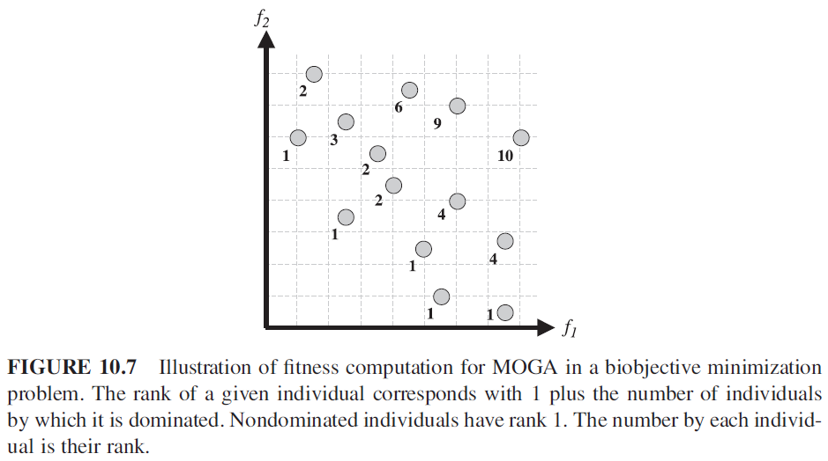

Slide 41
10.3.2.2.2 Diversity
An appropriate niching mechanism is necessary to prevent the algorithm from converging to a single region of the Pareto front
Allows differentiating individuals having identical ranks and favoring those that are in sparsely occupied regions of the objective space

Slide 42
10.3.2.2.3 Elitism
An elitist strategy refers to a mechanism by which the fittest individuals found during the evolutionary search are always copied to the next generation

Slide 43
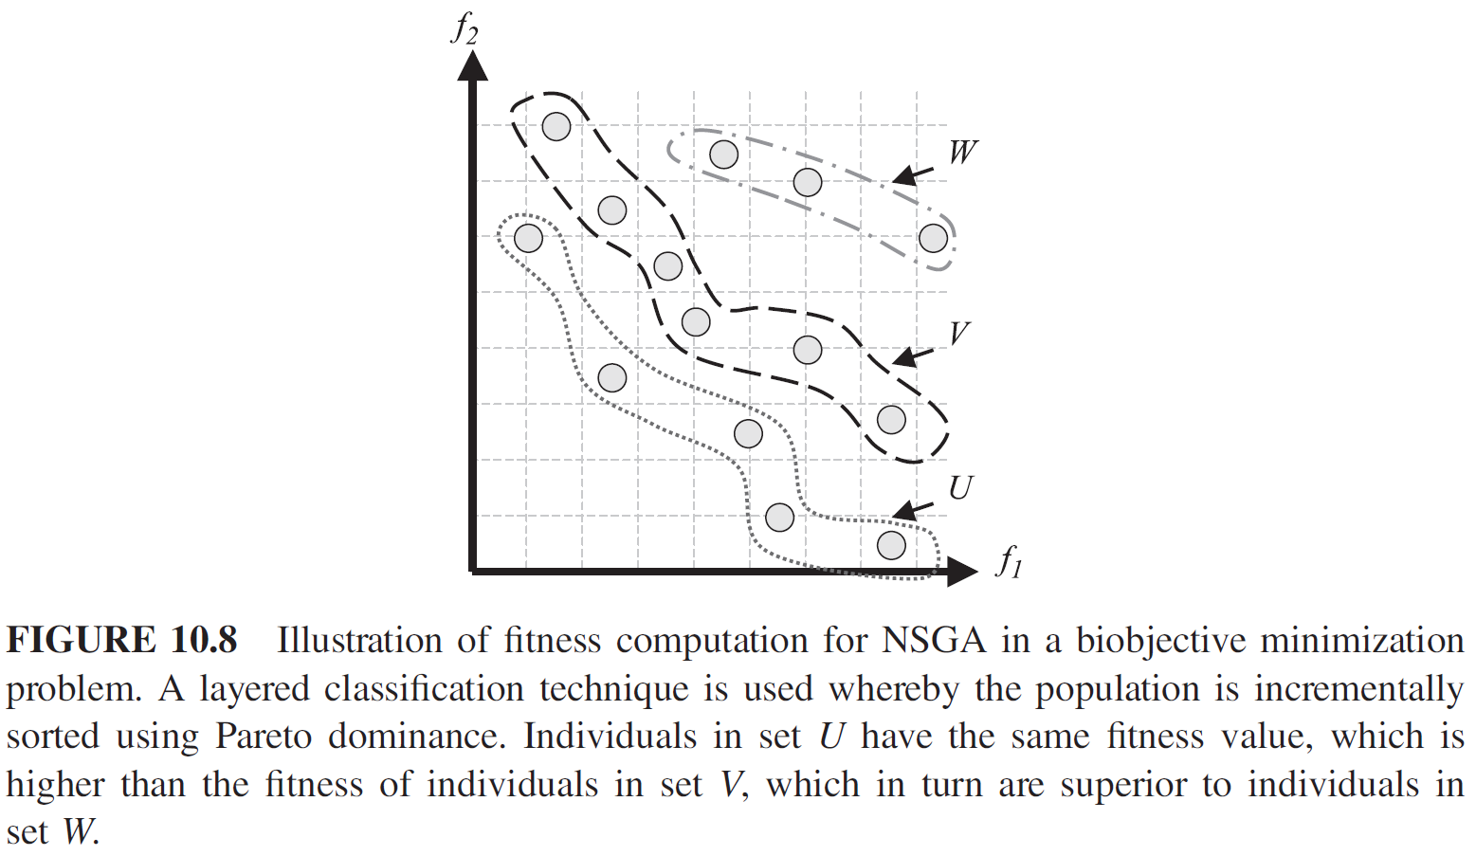
10.3.2.3 Common Population-Based MO Algorithms
Nondominated sorting genetic algorithm (NSGA) uses a layered classification technique

Slide 44
Strength pareto evolutionary algorithm (SPEA): a repository or external archive is used to maintain nondominated solutions and is updated at each generation if better nondominated solutions are found

Slide 45
Niched Pareto genetic algorithm (NPGA): two individuals are compared with respect to a comparison set

Slide 46
Multiobjective particle swarm optimizer (MOPSO): Pareto-dominance is used to update each particle’s personal best

Slide 47
10.4 PERFORMANCE ANALYSIS

Slide 48
10.4.1 Objective of Performance Assessment
Which algorithm is better?
For SOO
Speed
Solution quality
Reliability
For MOO
…
Distribution of Pareto set

Slide 49
10.4.2.1 Quality Indicators
Cardinality (i.e., number of solutions in the approximation set).
Generational distance, which is a measure of the distance of an approximation set to the Pareto front (if known). It is the average distance between points on solution set and nearest point of the true Pareto front.
Spacing, which quantifies the spread of solutions. It is the standard deviation of distance of points on solution front to nearest point on solution front.
The hypervolume indicator measures the size of the dominated region bounded by some reference point [11].

Slide 50
10.4.2.2 Attainment Function Method

